Slide 1

COVER / 01
Campus Assistant
Telegram Bot
Empowering Campus Life: A Cloud-Native Smart Assistant
Presenters:
Pang Wei, Zhou Xinyu, Zhao Sibo
Institution:
Hong Kong Baptist University (HKBU)
Date:
April 2026

Slide 2

PAGE 02
01
Project Overview & Demo
Vision, Core Features & AI Interaction
TOC
02
System Architecture
Tech Stack & Interaction Logic
Table of Contents
03
Cloud Infrastructure
Database & Managed Platform
PRESENTATION OUTLINE
04
Automation & Security
CI/CD, Resources & Protection
Comprehensive analysis of the project core,
From system architecture to cloud deployment,
Exploring technical implementation and value.
05
Summary & Outlook
Phase Review & Future Roadmap

Slide 3

01
CHAPTER ONE
PROJECT OVERVIEW
Creating a One-Stop Smart Portal for Campus Life

Slide 4



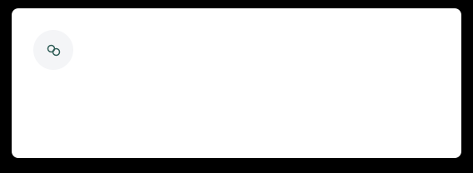
Project Vision & Core Features
@comp7940_campus_bot
An AI-powered Telegram bot designed to redefine efficiency in campus life.
AI Intelligent Chat
Task Management
Integrated with DeepSeek LLM for natural interaction.
Supports multi-language and long-context memory.
Full lifecycle: Create, List, Mark and Delete.
Keep your academic schedule clean and organized.
Campus Event Discovery
Study Buddy Matching
Filter campus activities precisely by categories.
Stay updated with real-time news and notifications.
Smart matching based on interests and courses.
Find the perfect partner to boost collaboration.
04 / 08

Slide 5
02
Part Two: System Architecture
Efficient, Stable, and Scalable Cloud-Native Design
05 / 12

Slide 6
06 / INFRASTRUCTURE
System Architecture Design
Asynchronous architecture based on Render containerization and DeepSeek AI-driven logic
Interaction Flow
User (Telegram)
Render (Python Bot)
DeepSeek API / Redis Cloud
Compute Layer
Storage Layer
AI Engine Layer
• Core Language: Python
• Deployment: Render Container
• Logic: Async Event-driven
• Auto-scaling Support
• Engine: Redis Cloud
• Session Context Persistence
• Task State Management
• Real-time User Profiling
• Model: DeepSeek API
• Natural Language Processing
• Intent & Semantic Extraction
• Stream Response Optimization
Monitoring Mechanism
Tracking real-time latency metrics to ensure system transparency and response stability.

Slide 7
03
PART 03: FEATURE DEMONSTRATION
Immersive Experience: From AI Interaction to Campus Socializing
SECTION 03 / 04

Slide 8


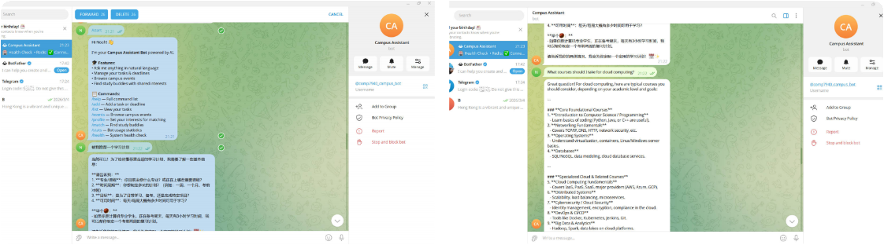
AI Intelligent Dialogue & Context Memory
ENHANCED NATURAL LANGUAGE PROCESSING
Multilingual Support
Context Awareness
Intelligent Assistant
Recognizes and responds in the user's
input language, providing a seamless
communication experience.
Uses Redis for history, enabling long
& short-term memory to understand
continuous conversational intent.
Customizes personalized study plans
based on students' specific majors
and future learning objectives.
APP DEMONSTRATION

Slide 9
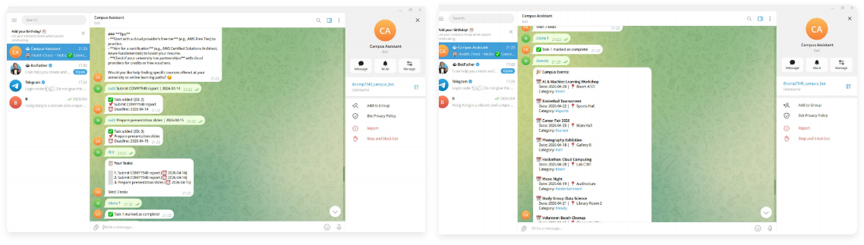
09 / FEATURE OVERVIEW
Task Management & Event Discovery
Task Tracking
Event Discovery
Interaction UX
Supports /add, /list, /done commands
Helping students manage deadlines efficiently
Browse events via /events command
Quick access by tags like #tech, #sports
Intuitive UI based on Telegram native
components for streamlined navigation

Slide 10
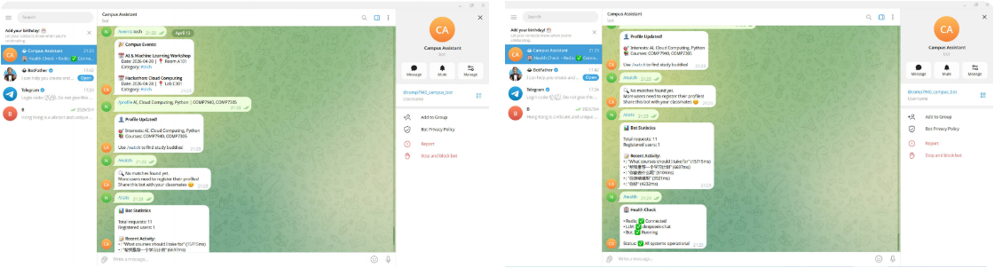
CORE FUNCTIONS / PLATFORM
Study Matching & System Monitoring
Precision Matching
Operations & Monitoring
/profile
/match
/health
/stats
Users configure interests and courses via commands,
enabling the system to find compatible study partners.
Real-time health checks for Redis and LLM connections,
tracking stats and latency to ensure high availability.

Slide 11
04
PART 04: CLOUD INFRASTRUCTURE
Elastic & Scalable Cloud Resource Configuration

Slide 12
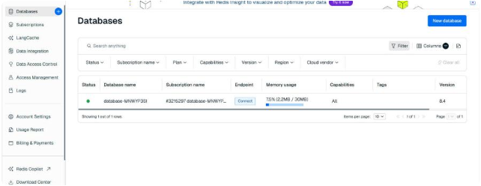
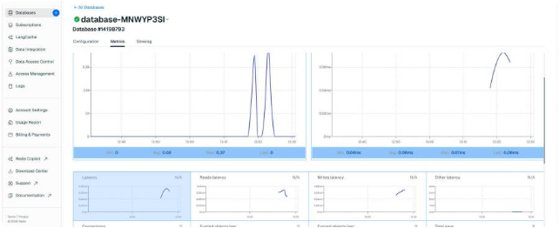
DATABASES OVERVIEW
Cloud Database: Redis Cloud
Deployment Strategy
· Hosted on AWS (us-east-1) managed nodes
· Redis Cloud Free Tier for cost-performance balance
Resource Utilization
PERFORMANCE METRICS
7.5%
· Memory usage is only 2.2MB (30MB quota)
· Utilization < 10%, fully meeting current needs
Core Applications
· High-performance cache for faster response
· Stores: Chat history, TODOs, profiles, and logs

Slide 13

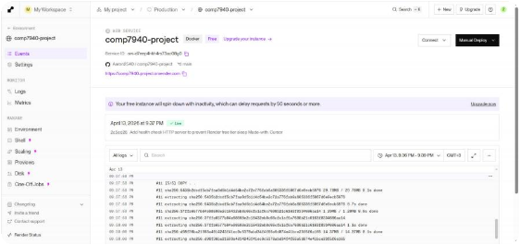
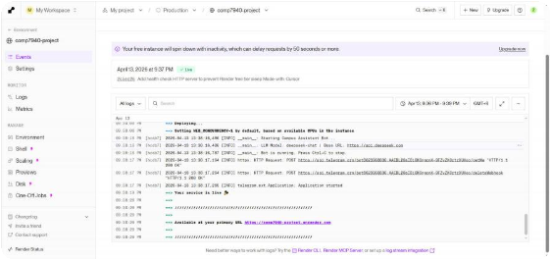
CLOUD HOSTING & DEPLOYMENT
Cloud Architecture
Deployment via Render
Modern Lightweight, Automated & High Availability Solution
Render Service Overview
Hosting Environment
Utilize Render Free Tier (512MB RAM, 0.1 CPU)
for efficient, low-cost project operation.
Automated Deployment
Integrated with GitHub to trigger Docker builds
and deployments automatically on every push.
High Availability
HTTP Health Check mechanisms to keep the
free instance active and prevent hibernation.
Real-time Logs & Monitoring

Slide 14
05
PART FIVE
Containerization & CI/CD
Standardized Delivery Workflow

Slide 15
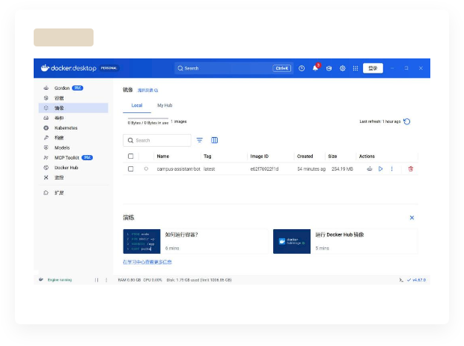
15 / Containerization Technology
Containerization Practice: Docker
Environment Consistency
DOCKER GUI
Built on python:3.11-slim
Image size optimized down to254MB
Service Orchestration
Managed via docker-compose.yml
Services: bot, redis, & exporter
Resource Control
Configured Limits & Health Checks
Ensuring stability in production
Visual Image Management: campus-assistant-bot deployment instance

Slide 16
16
CI/CD Automated Pipeline
AUTOMATED PIPELINE & QUALITY ASSURANCE
Continuous Integration (CI)
Continuous Deployment (CD)
Quality Assurance (QA)
· GitHub Actions workflow control
· Static code linting & analysis
· Automated Docker image builds
· Automatic merge to main branch
· Triggered Render cloud deployment
· Zero-downtime environment rollout
· Mandatory CI checks for all PRs
· Ensure code consistency & quality
· Enhance production stability
Automated toolchains enable a complete closed-loop from development to production, minimizing human error risks.

Slide 17
06
PART 06: COST & SECURITY
Ultimate Cost Control and Security Protection
SECTION 06 / PAGE 17

Slide 18

COST ANALYSIS
PROJECT ECONOMICS & EFFICIENCY
Zero-Cost Strategy (Free Tiers)
Primary Expenditure (Paid)
Telegram APIMessaging Interface
Render / DockerApp Hosting & Containers
DeepSeek LLM API Token Consumption
¥ 10.00
Redis CloudManaged In-Memory DB
GitHubVCS & CI/CD Pipeline
Approx. $ 1.37 USD
CONCLUSION: This project demonstrates building production-ready apps using free cloud tiers with extreme cost-efficiency.
PAGE 18

Slide 19

STRICTLY CONFIDENTIAL
Key Management
01
Sensitive info (API Keys) is stored via environment variables.
PAGE 19 / SYSTEM SECURITY
Security Measures
Version Control Security
02
Building a multi-layered defense system to ensure
full lifecycle security for core assets and data.
.env files are git-ignored to prevent configuration data leaks.
Platform Security
03
100%
Encrypted env variables and strong password authentication.
SECURED

Slide 20
Summary & Outlook
20 / 20
PROJECT CLOSURE & FUTURE ROADMAP
100%
Project Achievements
ACHIEVED
Future Roadmap
Successfully completed full-stack targets:
deployment, containerization, database
integration, monitoring, and CI/CD.
Integrate diverse campus data sources.
Refine LLM prompts for higher accuracy.
Explore multi-tenancy for wider groups.
Thanks for Listening!
Bot:
@comp7940_campus_bot
QUESTIONS & ANSWERS ARE WELCOME
GitHub:
Aaron2540/comp7940-project

